Slide 1


Biology in a Box
A science education outreach program brought to you by a partnership
between The University of Tennessee and the National Institute for Mathematical and Biological Synthesis
Visit us on the web at http://biologyinabox.utk.edu
Biology in a Box Team
Program Director/Author/Lead Editor: Dr. Susan E. Riechert (University of Tennessee)
Science Collaborators: Dr. Thomas C. Jones (East Tennessee State University), Dr. Stan Guffey (University of Tennessee)
Mathematics Collaborators/Editors: Dr. Suzanne Lenhart (NIMBioS), Kelly Sturner (NIMBioS), Lu Howard (University of Tennessee)
Outreach Coordinator: Dr. Lynn Champion (University of Tennessee)
Workshop Coordinators: Kathy DeWein (Austin Peay State University), Gale Stanley (Jacksboro Middle School)
Production/Assistant Editor: J.R. Jones (University of Tennessee)
Previous Contributors: Sarah Duncan, Communications (formerly with NIMBioS), Rachel Leander, Math Collaborator (formerly with NIMBioS)
This unit revised September 2012
Copyright 2012 by Biology in a Box, and the University of Tennessee. All materials in this unit and on the Biology in a Box web server (biologyinabox.utk.edu, eeb.bio.utk.edu/biologyinbox) may not be reproduced or stored in a retrieval system without prior written permission of the publisher, and in no case for profit.

Slide 2
Unit 4: SIMPLE MEASURES

Slide 3
Homepage
Click underlined text below to go to exercises and information!
Materials List
Introduction
Exercise 1: What is its mass?
Exercise 2: How is volume related to shape?
Exercise 3: Density
Exercise 4: Exploring object size, shape, density, & mass (Lower grades)
Suggested Reading
Links
Click the house icon on slides where
present to return to this page!

Slide 4
Materials List
Graduated cylinder
Beaker
Bucket for water
Funnel
Box with volume relationship set: cube, rectangular prism, cone, pyramid, cylinder, and sphere
Balance
Box with packing peanuts
Box with miscellaneous items such as hickory nuts, string, acorns, spiny seed pod, stone, cotton ball, feather, paper clips, noodles, plastic cap, felt pad, hexagonal weight, metal washer & jacks
Box with 40 circular discs
Materials list continues on the next slide.

Slide 5
Materials List (continued)
Box with plastic square weights: 4 yellow weights, 2 orange weights, 1 purple weight, 1 pink weight
Box with six calibration standard weights: 1g, 2g, 5g, 10g, 20g and 50g
Box with stop watch, cart, tape measure, string
Board
Box with miscellaneous items
Box with miscellaneous shells
Density block set
Rhinoceros Beetle
Morpho Butterfly

Slide 6
Introduction
Have you ever been measured?
  At your doctor’s office, you have probably been measured to determine your height and weight.
Have you ever measured anything?
  At the grocery store, you may have measured fruits and vegetables to determine how much you will pay for them.
Scientists measure things often. In order to compare the performance of objects of interest, they must know how similar or different they are.
Measuring answers questions such as:
  Which one has more mass?
  Which one takes up more space?
There are many different ways to measure an object.

Slide 7
The Student will…
Learn about mass/weight (Exercise 1),
Learn about volume and its relationship to shape (Exercise 2)
Learn about the concept of density (Exercise 3)
Learn how size, shape, mass, density, and materials are related (Exercise 4)

Slide 8
Exercise 1: What is its mass?
The MASS of an object is a measure of how much matter is present in the object.
One way to measure mass is by measuring how strongly a body resists changes in velocity (speed & direction). The more massive a body, the more difficult to make the body move faster, slower, or change direction.
  For instance, it is easier to push an empty shopping cart than a full one. Test this the next time you go to the grocery store.
Acceleration is the rate at which a body’s velocity changes. If a body’s velocity is changing, then we say that the body is accelerating. So, we can rephrase our previous statement about changes in velocity in terms of acceleration.
The more massive an object, the more difficult it is to accelerate!

Slide 9
Exercise 1: What is its mass?
Anything that can cause an object to accelerate is called a force.
  Gravity, magnetism, friction, and tension are examples of forces.
  If you hold your pencil up above your desk and then release it, the force of gravity will cause the pencil to fall to the desk.
  If you repeat this same experiment in outer space, beyond the reach of Earth’s gravity, the pencil will simply float in place. That is, its motion will stay the same.
  In this exercise, we will measure how gravity changes the motions of various objects, in order to discover how massive the objects are.

Slide 10
Exercise 1: What is its mass?
In the United States, we often talk in terms of how much an object weighs, but weight is actually a measure of the gravitational pull on an object.
You would have the same mass if you were standing on the surface of the moon or on the surface of the earth, but you would weigh less on the moon, because the gravitational pull of the moon is less than that of the earth.

Slide 11
Exercise 1: What is its mass?
In these activities, we will consider mass. Mass is expressed in the metric system of measurement. The units of mass units and the relations that exist between them are shown in the table below.
When completing scientific calculations, it is important that you keep track of all of your units, and that you are comfortable converting between units. The following example and exercises will help you learn how to convert between units.
Unit | Symbol | Relationship
milligram | mg
gram | g | 1000 mg
kilogram | kg | 1000 g
metric ton | t | 1000 kg

Slide 12

Exercise 1: What is its mass?
Example: How many grams are there in one milligram?
Answer: We start with the equation from the table that relates grams to milligrams.
Next we divide both sides of this equation through by 1000 so that the left hand side of the equation is equal to 1 mg, and convert the fraction to its decimal form.

Slide 13
Exercise 1: What is its mass?
Now, answer the following questions:
Q1. How many kilograms are there in one gram?
Q2. How many milligrams are there in one kilogram? How many milligrams are there in one metric ton?
Q3. How many kilograms are there in 800 grams?
Answers are on the next slide!

Slide 14
Answer Time!
Q1. How many kilograms are there in one gram?
1 g = 0.001 kg
Q2. How many milligrams are there in one kilogram? How many milligrams are there in one metric ton?
1 kg = 1,000,000 mg
1 metric ton = 1,000,000,000 mg
Q3. How many kilograms are there in 800 grams?
800 g = 0.800 kg

Slide 15
Exercise 1: What is its mass?
Experimental Setup
All exercises of mass and motion utilize the setup shown on on an upcoming slide.
Locate the box labeled 1a.
This box should contain a cart having the following characteristics: 4 wheels, a cavity to hold objects, and a hole in the front to insert a string. There should also be a measuring tape, a stopwatch, a pulley and a string with weight attached to it in the car box.
Clear a tabletop in the room.
You will set up the apparatus shown in the figure below, using a 50g mass.

Slide 16
Exercise 1: What is its mass?
Experimental Setup
If your table is to too thick for the pulley clamp, attach it to the enclosed piece of dry erase board instead, and weight the dry erase board down with a book or some other heavy object.
Place a barrier (e.g. book) under the string in front of the pulley, so that the cart does not fall off the end of the table.
Mark a starting line at the other end of the table. At the beginning of each trial, the front wheels of the cart should be even with the starting line.
The distance between the starting line and the end barrier is your track length.
Your track length must be less than the height of the table.

Slide 17
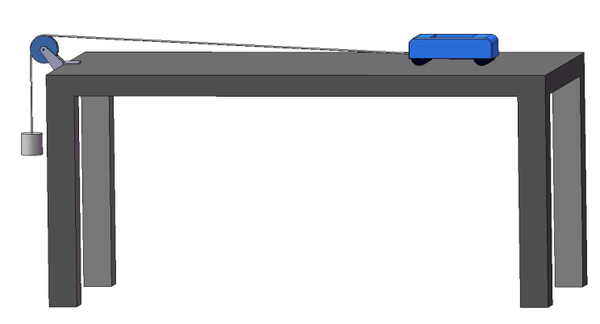
Exercise 1: What is its mass?
Experimental Setup
Insert book or other stop under string at end of table

Slide 18
Exercise 1: What is its mass?
For exercises for lower grades, using less complicated mathematics, click here:
For exercises for higher grades, using more involved mathematics, click here:

Slide 19
Exercise 1a1. Items of known mass (Lower Grades)
Find the box which contains a series of calibration weights.
Load one calibration weight into the cart while holding it at the starting line.
Write the mass of the calibration weight down on a sheet of paper, or on the board at the front of the room (number on weight = mass in grams).
One person should release the cart while a second person uses the stop watch to find the time it takes the cart to travel the track (hit the stop).
Write down the number of seconds it took for the object to travel the track.
Repeat this process for all of the weights.

Slide 20
Exercise 1a1. Items of known mass (Lower Grades)
Order the weights from the shortest time to cross the table to the longest time.
Answer the following question.
Q1. How is the time it took the cart to travel the track related to the mass of the object in the cart? Click for the answer!
Answer: The greater the mass of the object in the cart, the longer it should have taken for the cart to travel the track.

Slide 21
Exercise 1a2. Ranking items based on travel time (Lower Grades)
Find the box which contains a number of objects of unknown mass.
You will also need your box of calibration weights from the previous exercise.
Find additional objects from around your room that are small enough to fit into the well of the cart.
Repeat Experiment 1a with each of these objects.

Slide 22
Exercise 1a2. Ranking items based on travel time (Lower Grades)
Order your objects in a row, from most massive to least massive, based on the time it took each one to travel the track.
Situate your calibration weights from Exercise 1a in this same row according to the time it took each one to travel the track.
Conclude something about the mass of each of your unknown objects. For example, you might conclude that a paper clip has more mass than the 2 gram calibration weight, but that it has a mass less than that of the 5 gram weight.

Slide 23
Which has more mass?
For each item below, decide which of the two animals listed is the most massive. Record your choice on the board at the front of the room. Click the question mark button at the end of each set of choices to check your answers.
A meat eater that ambushes its prey or a meat eater that chases its prey
A bird with functional wings or a flightless bird such as an ostrich
A soaring/gliding bird (such as a vulture) or a song bird
A beetle ( e.g. rhinocerous beetle included in your box) that bores into rotting logs and litter on the forest floor or a butterfly (also in te box) that visits flowers
A centipede or a millipede

Slide 24
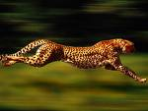

An active chasing predator, such as the cheetah at left, is lighter (less massive) than an ambush predator, such as the panther at the right.

Slide 25
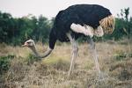
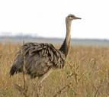
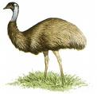
Flightless birds are of greater mass than birds with wings used for flight. Lower masses make it easier for birds to obtain loft at lower wind speeds. The flightless, fully terrestrial birds are the most massive of all bird species. Some soaring birds may be of larger mass than the swimming flightless penguins, but penguins have more mass for their size than vultures, condors, and eagles.
From left to right: Ostriches (from Africa), rheas (from South America), and emus (from Australia) are all massive flightless birds.

Slide 26
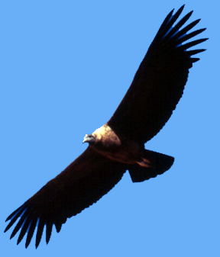
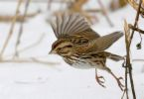
Birds of large mass have difficulty getting off of the ground. They require fairly high wind speeds to do so, and thus usually start flight from perches. These birds soar/glide on warm thermal updrafts of air with wings spread to keep aloft. The largest of the soaring birds is the condor, which roosts where it can easily launch itself into flight with just a few wing beats. Roost sites include large trees, snags, cliffs, and rocky outcrops. The song bird below has a mass of about 50g: the condor has a mass of 11,350g. The mass of a condor is thus 227 times greater than that of a typical song bird.
Birds that rely on soaring flight, like the condor (above left) are often much more massive than birds that rely on active flight, like songbirds (above right).

Slide 27
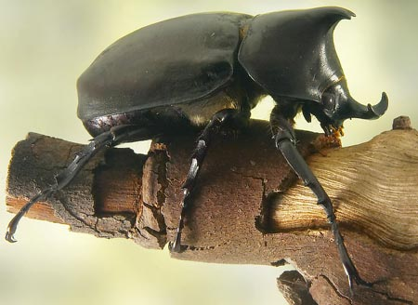
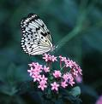
Forest beetles, such as rhinoceros beetles are often quite massive, and flight is mostly restricted to searching for mates. They are, in fact, unable to change direction in flight, and thus must crash into something and fall to the ground to change course. Scientists believe that the rhinoceros beetle is the strongest animal on earth for its size, something that permits it to be able to forage through heavy litter on the forest floor and dig underground, where it is safe from predators. Butterflies are active flyers that visit flowers. They definitely have less mass than the detritus-boring beetles. Find the rhinoceros beetle and butterfly in your trunk.

Slide 28


Though centipedes and millipedes are closely related animals belonging to the Class Myriapoda, the centipedes (below left) are active predators that chase down their prey in high gear locomotion. They are of much less mass than the millipedes (below right), which are detritivores, feeding on rotting logs. The millipede is a low gear animal that has two pair of legs per segment compared to the centipede, which has only one pair of legs per body segment. The millipedes use their greater mass in generating digging power.

Slide 29
Exercise 1a2. Ranking items based on travel time (Lower Grades)
Q1. For each item below, decide which of the two animals listed is the most massive. Record your choice on the board at the front of the room. Click the question mark button at the end of each set of choices to check your answers.
A meat eater that ambushes its prey or a meat eater that chases its prey
A bird with functional wings or a flightless bird such as an ostrich
A soaring/gliding bird (such as a vulture) or a song bird
A beetle that bores into rotting logs and litter on the forest floor or a butterfly that visits flowers
A centipede or a millipede

Slide 30
Exercise 1a1. Items of known mass (Higher Grades)
Load the most massive calibration weight into the cart while holding it at the starting line.
When you are ready, start the stopwatch and let go of the cart simultaneously.
Stop the stopwatch when the cart reaches the finish line.
For each object, record the time it takes for the cart to travel the track, and the mass of the weight used.
Repeat with each of the remaining weights.
Establish a qualitative relationship between the time it takes the cart to travel the track, and the mass of the object in the cart.
Make a scatter plot of the mass, m, of the object in the cart versus the time, t, it took the cart to travel the track. Label the x-axis t and the y-axis m.

Slide 31
Exercise 1a2. Obtaining the mass of unknowns using Newton’s laws of motion. (Higher Grades)
In this exercise, you will calculate the mass of several objects using Newton’s laws of motion.
The velocity (speed and direction) of a body does not change unless the body is acted on by an external force.
The net force acting on a body is equal to the product of the acceleration of the body and the mass of the body, that is,
F = ma
In this equation, mass, m, is measured in kg, and acceleration, a, is measured in m/s². The units of force are thus measured in (kg∙m)/s²
If one body exerts a force on a second body, then the second body exerts a force of equal magnitude and opposite direction on the first body.

Slide 32
Exercise 1a2. Obtaining the mass of unknowns using Newton’s laws of motion. (Higher Grades)
Answer the following questions:
Q1. Suppose two bodies have an acceleration of 8m/s². The mass of the first body is 3g and the mass of the second body is 10g. Find the force acting on both bodies. Which body had a greater force acting upon it? Make sure you find the answer using standard units of mass and force!
Q2. Rearrange the equation in Newton’s second law to solve for a in terms of m and F.
Q3. Suppose that a force of 10(kg∙m)/s² is applied to a body with a mass of 50g. What is the acceleration of the body? How much force would be needed to give a body with a mass of 100g the same acceleration? Does this agree with our previous statements relating mass and acceleration? Be careful with your units!
Answers are on the next slides!

Slide 33
Exercise 1a2. Answers (Higher Grades)
Q1. Suppose two bodies have an acceleration of 8m/s². The mass of the first body is 3g and the mass of the second body is 10g. Find the force acting on both bodies. Which body had a greater force acting upon it? Make sure you find the answer using standard units of mass and force! Click for the answer!
The force on the first body is 8m/s² × 0.003kg = 0.024 m·kg/s².
The force on the second body is 8m/s² × 0.01kg = 0.08 m·kg/s².
The force on the second body is greater.
Q2. Rearrange the equation in Newton’s second law to solve for a in terms of m and F. Click for the answer!
a=F/m

Slide 34
Exercise 1a2. Answers (Higher Grades)
Q3. Suppose that a force of 10(kg∙m)/s² is applied to a body with a mass of 50g. What is the acceleration of the body? How much force would be needed to give a body with a mass of 100g the same acceleration? Does this agree with our previous statements relating mass and acceleration? Be careful with your units! Click for the answer!
The acceleration of the first body is (10kg·m/s²)/(0.05kg) = 200 m/s².
If a 100g body has an acceleration of 200 m/s², then the force on the body is
F = 0.1kg × 200 m/s² = 20 kg·m/s².
Therefore, it takes twice as much force to give a 100g body the same acceleration as a 50g body!

Slide 35
Exercise 1a2. Obtaining the mass of unknowns using Newton’s laws of motion. (Higher Grades)
Identify small objects from around the room that will fit in the cart’s well and run in the same experiment you completed under Exercise 1a with each one.
Record your results in a table that has the name of each object in the first column, the time it took to travel the track in the 2nd column and a blank column entitled object’s mass.
Rank these objects along with the calibration weights in a list from least massive to most massive. (The class might vote on the relative position of each item).
Go to the next slide for some information that can help you calculate the masses of your chosen objects.

Slide 36
Exercise 1a2. Obtaining the mass of unknowns using Newton’s laws of motion. (Higher Grades)
The following items of information are needed to determine the mass of each object.
  The acceleration due to gravity: 9.81 m/s² (m = meters & s = seconds)
  The mass of the cart: 56 g = 0.056 kg
  The mass of the calibration weight : 0.05 kg
  The time, t₁, it takes the cart to travel the track. (Note: d_{track} should be measured in meters).

Slide 37
Exercise 1a2. Obtaining the mass of unknowns using Newton’s laws of motion. (Higher Grades)
Now we are ready to calculate the mass of each object. Since the cart and the weight are joined by a string and pulley, any change in the position of the string results in an equal change in the position of the cart. So, the acceleration of the cart is equal to that of the string. We will call this the system acceleration and denote it as a_{s}.
Step 1. Calculate the system acceleration, a_{s}.
When an object is accelerating, the relationship between the distance the object has traveled and the object’s acceleration is: d = v₀t + ½ (at²)
Where d is the distance traveled, v_{o} is the initial velocity, a is the acceleration, and t is the time it takes the object to travel the distance, d. In the cart experiment, a=a_{s}, d=d_{track}, and t=t₁. So, the relationship is
d_{track} = v₀t₁ + ½ (a_{s}t²)
Initially the cart is at rest, and therefore the initial velocity, v_{o}, is zero. Thus the relationship becomes:
d_{track} = ½ (a_{s}t²)

Slide 38
Exercise 1a2. Obtaining the mass of unknowns using Newton’s laws of motion. (Higher Grades)
Initially the cart is at rest, and therefore the initial velocity, v_{o}, is zero. Thus the relationship becomes:
d_{track} = ½ (a_{s}t²)
Q4. Rearrange the equation above to solve for a_{s} in terms of d_{track} and t.
Click again for the answer!
a_{s}=2d_{track}/t²
Step 2. Calculate the gravitational force on the calibration weight.
On earth, the acceleration of a free falling body is 9.81 m/s2. Therefore the gravitational force, Fg, on a 5g weight is
F_{g} = m_{w} × g = 0.05 kg × 9.81 m/s² ≈ 0.49 kg·m/s²

Slide 39
Exercise 1a2. Obtaining the mass of unknowns using Newton’s laws of motion. (Higher Grades)
Step 3: Calculate the tension on the string.
The force of gravity on the calibration weight is opposed by the tension force, T, on the string. The net force on the calibration weight, F_{w}, is the difference of these two forces, that is
F_{w} = F_{g}-T = 0.49 (kg × m)/s² – T
Q5. Use Newton’s second law to find F_{w} in terms of a_{s} and m_{w}.
Q6. Find T in terms of a_{s}.
Answers to these questions are on the next slide!

Slide 40
Exercise 1a2. Obtaining the mass of unknowns using Newton’s laws of motion. (Higher Grades)
Q5. Use Newton’s second law to find F_{w} in terms of a_{s} and m_{w}.
Fw = m_{w} × a_{s} = 0.05 (kg × m)/s² × a_{s}
Q6. Find T in terms of a_{s}.
Since Fw = m_{w} × a_{s} = 0.05 (kg × m)/s² × a_{s}
AND
Fw = 0.49 (kg × m)/s² – T
Then 0.05 (kg × m)/s² × a_{s} = 0.49 (kg × m)/s² – T
SO
T = 0.49 (kg × m)/s² - 0.05 kg × a_{s}

Slide 41

Exercise 1a2. Obtaining the mass of unknowns using Newton’s laws of motion. (Higher Grades)
Step 4. Use Newton’s second law to find the combined mass of the cart and object, m_{tot}.
The cart is being pulled by the tension, or pulling force, in the string. Therefore, the force on the cart, F_{c}, is equal to T.
By Newton’s second law, F_{c} is also the product of the cart’s mass and its acceleration.
F_{c} = m_{tot} × a_{s}
Q7. Solve for m_{tot}. Click for the answer!

Slide 42
Exercise 1a2. Obtaining the mass of unknowns using Newton’s laws of motion. (Higher Grades)
Step 5. Find the mass of each object.
To find the mass of each object, simply subtract the mass of the cart (m_{cart}) from the combined mass of the cart and object (m_{tot}).
Note that the masses m_{tot} and m_{cart} must be in kilograms, or at least in the same units, for your answer to make sense.
Complete your table by recording the mass of each object.
Add the data points for the unknown objects to the graph you have made of mass versus time to travel the track.
Test the ranking obtained from your table and graph against your original ranking of items by mass.

Slide 43
Exercise 1a2. Obtaining the mass of unknowns using Newton’s laws of motion. (Higher Grades)
Answer the following questions.
Q8 .What are some possible explanations for any differences between the first (qualitative) and second (quantitative) rankings you developed?
Q9. What objects were the heaviest? The lightest?
Q10. Can you tell by looking at the various objects which ones had more matter in them?

Slide 44
Exercise 1b. What is its mass? - Directions
TO BEGIN….
You will need:
Balance (provided)
Box with circular discs/rings
Box with colored blocks
Note: This balance will not give a numerical value of how much an object weighs or what its mass is. However, you can balance an object of unknown mass to a series of objects of known mass in determining the mass of the object in question.

Slide 45
Directions continued
To ensure that the rings weigh the same, the teacher should…
  Have a student take two rings out of the box and place one ring on one tray of the balance and the other on the other tray.
  If the two trays balance (are level with one another), then the two rings are of equal mass.
Other students might take additional rings from the box and repeat this comparison to ensure that the rings are all of the same mass.

Slide 46
Directions continued
Next find the box with colored blocks in it.
Place one ring and one square purple weight on a table in front of the class.
Have the students vote on which item looks as though it will weigh more or have more mass.
Now you are ready to pass a pair of the two weights around the class so that each student has the opportunity to hold a ring weight in one hand and a square purple weight in the other hand.
Have a vote on which object feels heavier.

Slide 47
Directions continued
Let’s see which object actually has more MASS.
Have a volunteer place a square purple weight on the left tray of the balance and a ring weight on the right side of the balance.
Note: If one object is heavier than the other is, the balance will be lop-sided and the heavier object will weigh its side of the balance down.
Repeat this procedure with the ring weight on the left side of the balance and the purple square weight on the right side.
Question 1. Which object has more mass: the square purple weight or the ring?
STOP!!! Answer is next!
Answer: The square purple weight has the higher mass.

Slide 48
Directions continued
Determine how many rings are needed to equal the mass of the purple block.
  A volunteer will place the square purple weight on one side of the balance
  He/she will add rings to the other side until the class agrees that the two sides of the balance are level (at the same height).

Slide 49
Exercise 1b continued
Question 2. How many rings did you use?
STOP!!! Answer is next!
Answer: It takes 10 rings to equal the mass of the square purple weight.
Repeat the same procedures for the orange block.
Question 3. Which weighs more, the ring or the square orange weight?
STOP!!! Answer is next!
Answer: The square orange weight has the higher mass.

Slide 50
Exercise 1b continued
Question 4. How many ring weights equal a square orange weight?
  To answer this question, have a student volunteer add ring weights to that side of the balance until the pans are at equal height. Click for the answer!
Answer: It takes 5 rings to equal the mass of the square orange weight.
Question 5. Judging from how many rings you used to equal the masses of square purple and square orange weights, what conclusions can you make about the mass of each square weight relative to that of the ring weight? Click for the answer!
Answer: The purple square weight is ten times as heavy as one ring weight and the orange square weight is five times the mass of a ring weight.

Slide 51
Exercise 1b continued
Question 6. What is the relative mass of the square purple weight and the square orange weight if 10 rings are equal to one square purple weight and 5 rings are needed to balance one square orange weight? Click for the answer!
The square purple weight is two times heavier than the orange weight.
Test this hypothesis (guess) by placing a square purple weight on one side of the balance and 2 orange weights on the other side.
Repeat the same procedures for the yellow block.
Question 7. What is the mass of one ring relative to a yellow square weight? Click for the answer!
Answer: The ring weight and yellow square weight are equal in mass

Slide 52
Exercise 1b continued
Thus far, you have been determining the relative weights or masses of objects.
Balances or scales have sets of standard weights associated with them. These weights are of known mass and are used to calibrate the scale (adjust the mechanism to ensure that it provides an accurate weight).
We can use these standard weights to determine the absolute mass of a single weight, that of the ring.
Find the calibration/standard weights.
Have volunteers try each standard weight versus a single ring weight on the balance until one is found that makes the two pans of the scale level.

Slide 53
Exercise 1b continued
Check the mass of the standard weight that matches the weight of the ring weight. (The mass of each standard metal weight is inscribed on its top where 1 = 1 gm, 20 = 20 gms and so on. )
The class should now be able to answer the questions that follow!

Slide 54
Exercise 1b continued
Question 8. What is the mass of a ring weight? Click for the answer!
Answer: 1 gram
Question 9. What is the mass of the purple square weight? Click for the answer!
Answer: 10 grams
Question 10. What is the mass of the purple square weight? Click for the answer!
Answer: 5 grams
Question 11. What is the mass of the yellow square weight? Click for the answer!
Answer: 1 gram

Slide 55
Exercise 2:
How is Volume Related to Shape?
Measuring an object’s volume answers the question of
  "How much space does it take up?“
  How much room an object or group of objects occupies describes its VOLUME.
A simple way to think of volume is to picture how much of something can fit inside something else.
  For example, a swimming pool can hold a certain volume of water.

Slide 56
Objective
Students will explore volume and its relationship to shape, using the following materials:
Volume relationship set, which includes a cube, rectangular prism, cone, cylinder, pyramid, & sphere.
Beaker
Funnel
1000 mL graduated cylinder
Plastic pan to catch spilled water
Bucket (to serve as water reservoir)
Box of miscellaneous objects

Slide 57
Directions
Examine the six containers in the volume relationship set.
Try to imagine which of the shapes can hold the same amount of water, or which ones look as though they take up the same amount of space (have the same volume)?
Let’s find out if you have guessed correctly.

Slide 58
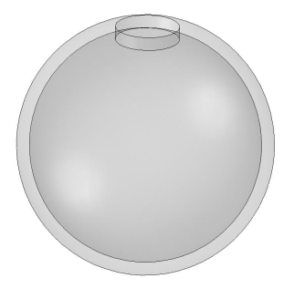
Directions
Find the round sphere pictured below, and place it in the container with its opening facing up.
Using the cup and funnel, fill the sphere with water. (ALL POURING OF WATER SHOULD BE DONE OVER THE PLASTIC PAN.) Do this slowly to avoid spilling.
Q1. Just by looking, what container do you think holds the same volume of water as the sphere? HINT: There is only one shape that holds the same amount of water as the sphere. Go to the next slide for instructions on how to find out!

Slide 59
Directions
Pour the water from the sphere into the container you have chosen as being similar in volume. If you have water left in the sphere, then the container you have chosen is too small. If the new container is not filled to the top with the water from the sphere, then it has a larger volume than the sphere.
Keep filling containers until you have found one that will hold the same volume of water as the sphere.
Q1. Just by looking, what container do you think holds the same volume of water as the sphere? HINT: There is only one shape that holds the same amount of water as the sphere. Click for the answer.

Slide 60
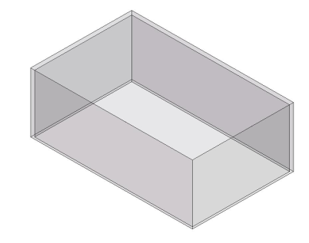
Directions
Find the rectangular box pictured below and fill it with water.
Q2. Now follow the directions on the next slide to find the container that holds TWICE (2X) the amount of water as the rectangular box. Click for the answer.
Pour the water from the rectangular box into the container you have chosen. You should then have an empty rectangular box and another partially filled container.
Fill the rectangular box with water one more time, and pour as much of this water as you can into the container you chose.
If you guessed the correctly, the container that you chose should be full of water and the rectangular box should be empty.
If this is not the case, choose another container and try again.

Slide 61
Directions
Pour the water from the rectangular box into the container you have chosen. You should then have an empty rectangular box and another partially filled container.
Fill the rectangular box with water one more time, and pour as much of this water as you can into the container you chose.
If you guessed the correctly, the container that you chose should be full of water and the rectangular box should be empty.
If this is not the case, choose another container and try again.
Q2. Which container holds TWICE (2X) the amount of water as the rectangular box? Click for the answer.

Slide 62
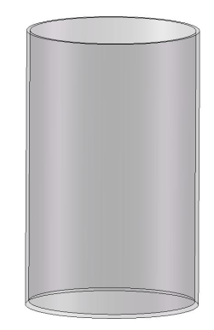
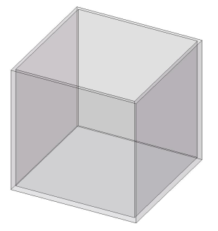
Directions
Look in volume relationship set box for the cylinder and cube pictured below.
Q3. Do you think the cylinder holds as much water as the cube, or do you think one of these containers holds more than the other?
Slowly pour the water from the cube into the cylinder to learn whether your guess was correct. Click for the answer!

Slide 63
Directions
Pour the water from both containers back into the bucket.
Turn the empty cube upside down so that the open side is facing down.
Set the cylinder on top of the cube. Can you tell by looking down at the containers why one has a higher volume? HINT: It has to do with shape! Click for the answer!

Slide 64
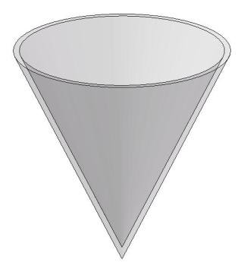
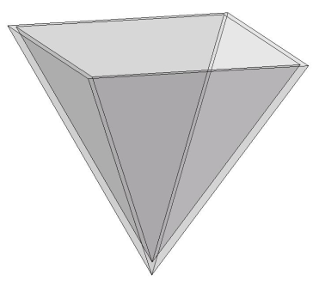
Directions
There are two containers left in the box that we have yet to examine. One is a cone (think ice cream!) and the other a pyramid.
Observe the size and shape of these containers. Are the containers the same height? Yes, the cone and pyramid are equally tall.
Q5. Do a cone and pyramid of equal height have equal volumes? Think carefully! If you are having trouble, look at the bases of the containers and remember the cube vs. cylinder comparison. One has a square base, and the other a circular base. Click for the answer!
Slide the cone into the pyramid. Now you should be able to tell which one has the greater volume.
Fill the pyramid with water, and then pour the water into the cone. You should find that the water from the pyramid does not quite fit into the cone. Thus, shape affects volume!

Slide 65
Directions
Q5. Do a cone and pyramid of equal height have equal volumes? Think carefully! If you are having trouble, look at the bases of the containers and remember the cube vs. cylinder comparison. One has a square base, and the other a circular base. Click for the answer!
Slide the cone into the pyramid. Now you should be able to tell which one has the greater volume.
Fill the pyramid with water, and then pour the water into the cone. You should find that the water from the pyramid does not quite fit into the cone. Thus, shape affects volume!

Slide 66
Question 1. What container holds the same volume of water as the sphere?
Click for the answer!
Answer: The rectangular container holds the
same volume as the sphere. Is this the shape
the class chose as being visually similar?

Slide 67

Leave the rectangular box filled with water following completion of test 1 as it will be used in answering question 2.
Question 2. Which container holds TWICE the amount of water as the rectangular box?
Which container can you eliminate without testing? HINT: See answer to Question 1.
Click for the answer!
Answer: You should have determined that the cube container holds twice the volume of water that the rectangular prism holds. This can also be stated as the rectangular prism has half the volume of the cube.

Slide 68
Question 3. Do the cube and cylinder have the same volume?
        Click for the answer!
Answer: You should have answered "no". The cube container has a higher volume than the cylinder. It holds more water.
Pour the water from both containers back into the bucket.

Slide 69
Question 4: Can you tell by looking down at the containers why one has a higher volume? HINT: It has to do with shape!
        STOP!!! Answer is next!
Answer: The corners of the cube add extra space, and this leads to its greater volume when compared to a cylinder of equal height (when the diameter of the cylinder is the same as the length of a side of the cube). Thus, an object’s shape can affect its volume. And, once again, looks can be deceiving!
You can check this yourself using the formulas for the volume of each shape, using x for the length of the side of the cube, and x/2 as the radius of the cylinder!
x³ > (π/4)x³

Slide 70
Question 5. Are the volumes of a cone and pyramid that are equally tall equal? Think carefully! If you are having trouble, look at the bases of the containers and remember the cube vs. cylinder comparison. One has a square base, and the other a circular base.
Slide the cone into the pyramid. Now you should be able to see which one has the greater volume.
STOP!!! Answer is next!
Answer: The pyramid has a slightly higher volume than the cone because it has a square instead of a circular base. In a pyramid with a square base and cone of equal height, where the diameter of the cone is equal to the length of the side of the pyramid’s base, the corners of the pyramid’s base allow for more room (volume). Check this yourself using formulas!

Slide 71
Directions
Finally, let's see if we can determine the volume of each shape available to us. To do this, you will need the beaker provided and the graduated cylinder (tall thin container).
Begin by choosing one of the shapes. Then, fill it to the top with water.
With the aid of the funnel, carefully pour the water that filled the container into the beaker and try to read the measurement in milliliters on the side of the beaker.
Can you make a very accurate measurement of the volume of water using the beaker? Let’s see if we can get a more accurate measurement of the shape you have chosen.
Again with the aid of the funnel, pour the water you had in the beaker into the graduated cylinder.
Read the measurement on the side of the graduated cylinder.
Q6. What is the volume of the shape you have selected? (The answer should be in milliliters).
Repeat this process for the rest of the shapes and compare them.
Q7. Which shape has the biggest volume? Which has the smallest volume?
Please place the empty clear containers back into the proper boxes, and return these to the trunk.

Slide 72
Exercise 2b. Find the exact volume of these shapes.
There are formulas that allow you to calculate the exact volumes of geometric solids. These formulas are listed in the table below. Use these formulas to determine the volume of each container. Measure each shape (in cm) to calculate their volumes in mL (1 mL = 1 cm³). Approximate answers are given on the next slide!
Geometric Solid | Volume | Explanation
Sphere | V = 4πr³/3 | r = radius
Rectangular prism | V = lwh | l = length; w = width; h = height
Cube | V = lwh | l = length; w = width; h = height (In a true cube, these are all the same!)
Cylinder | V = πr²h | r = radius; h = height
Right cone | V = ⅓πr²h | r = radius; h = height
Square pyramid | V = ⅓w²h | w = one side of the square base; h = height

Slide 73
Exercise 2. How is volume related to shape?
Below are the approximate volumes of each of the shapes in the volume set.
  Cube: Approximately 1000 mL.
  Rectangular prism: approximately 450 mL.
  Sphere: approximately 450 mL.
  Pyramid: approximately 400 mL.
  Cone: approximately 370 mL.
  Cylinder: approximately 800 mL.

Slide 74
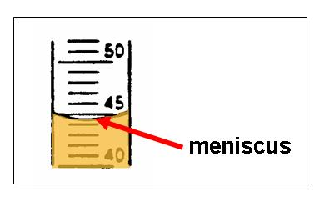
Exercise 2c. Finding the volume of irregular solids using displacement.
Some solids, like the shells in this unit, have irregular shape and cannot be measured to find volume. However, there is another method to find the volume of irregular solids. To use this method, you will need to accurately measure the volume of a liquid in a cylinder.
When a liquid is put into a cylinder, it does something unusual. It curves. This curve is caused by a quality that liquids have called surface tension.
When you read the graduated cylinder, you read it at the bottom of the curve. This is called the meniscus.

Slide 75
Exercise 2c. Finding the volume of irregular solids using displacement.
Place the graduated cylinder on the table for an accurate reading
Place some water in the graduated cylinder (approximately 90 ml) and note the meniscus.
Be sure to get down to eye level with the meniscus in order to read the exact volume in ml present.
Write down the exact amount of water you have in the graduated cylinder. This is your Initial Volume.
Now place your shells in a row from smallest to largest based on visual inspection. Each shell has a letter on it.
Record your shell ranking on the board at the front of the room.

Slide 76
Exercise 2c. Finding the volume of irregular solids using displacement.
Now let’s measure the volume of the shells so we can see how our qualitative ranking based on estimation by sight compares to our quantitative ranking based on measurement.
Place a shell into the water without splashing any water out of the cylinder.
Read the new level of water in the graduated cylinder (to the bottom of the meniscus). Write this down as your Final Volume .
Subtract the initial volume from the final volume. This difference is the volume of the shell.
Repeat these steps for each of the shells.
Now rank the shells from lowest volume to greatest volume, and record your ranking on the board. Compare your two ranking systems.

Slide 77
Exercise 2c. Finding the volume of irregular solids using displacement.
Using your volume measurements, you can actually determine how much larger (greater in volume) each shell in the ranking is than the previous shell.
This is done be completing ratios.
Example: Let’s suppose you had the following set of quantitative data:
  Shell 1 volume: 1.2 mL
  Shell 2 volume: 2.4 mL
  Shell 3 volume: 3.3 mL
  Shell 4 volume: 3.9 mL
  Shell 5 volume: 4.6 mL

Slide 78


Exercise 2c. Finding the volume of irregular solids using displacement.
To find how much more volume shell 2 has than shell 1, we calculate the ratio
That is, shell 2 has twice as much volume as shell 1.
Similarly, we can find how much more volume shell 3 has than shell 2.
That is, shell 3 has 1.375 times the volume of shell 2

Slide 79
Exercise 2c. Finding the volume of irregular solids using displacement.
Shell Number | Volume | Size relative to next lower shell
1 | 1.2 mL
2 | 2.4 mL | 2 times greater than #1
3 | 3.3 mL | 1.375 times greater than #2
4 | 3.9 mL
5 | 4.6 mL
Finish the table above.
Complete a similar table for your shell sample.

Slide 80
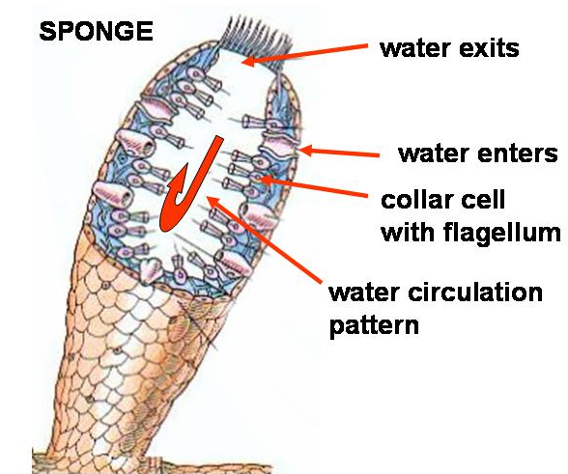
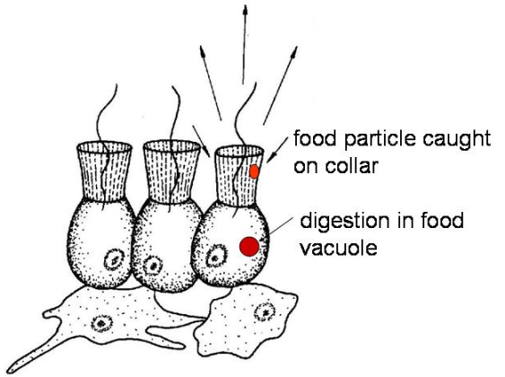
Exercise 2c. Supersolver Questions
Q8. The sponge is a filter-feeder: it circulates water through an internal cavity to obtain oxygen and gather food particles (bacteria and dead organic matter) on its collar cells. Wastes are also eliminated, as the beating of flagella generates the flow of water through the sponge’s central cavity. What volume of water does a filter-feeding sponge cycle through its cavity per day if its flagella create a current flow of 75 liters of water/ hr?
Q9. Since the typical sponge pumps a volume of water per minute equal to about 5 times its body volume, what is the volume of the sponge under Q8?
For animation of sponge feeding, click HERE.

Slide 81
Exercise 2c. Supersolver Questions
Q9. Since the typical sponge pumps a volume of water per minute equal to about 5 times its body volume, what is the volume of the sponge under Q8?
For animation of sponge feeding, click HERE.

Slide 82
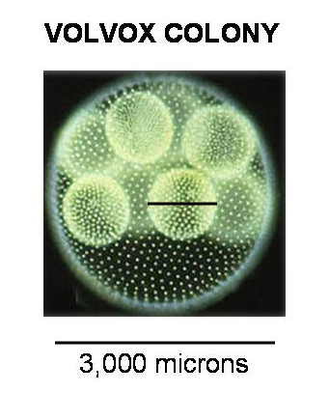
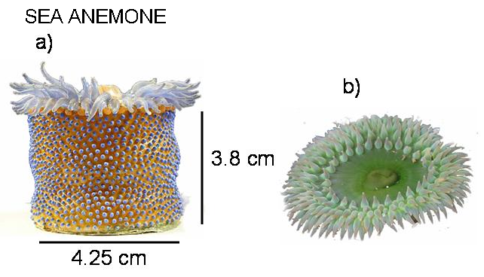
Exercise 2c. Supersolver Questions
Q10. The sea anemone pumps water into its body to assume its feeding form, see figure a). When it is frightened by a predator, it contracts strong longitudinal muscles and flattens to the form shown in figure b. If the anemone contracted to 10% of the height of its feeding form, with no changes in diameter, what volume of water did this anemone force out?
Q11. Volvox is found in freshwater ponds, puddles, and ditches. It is a chlorophyte (algal protist) that forms spherical colonies. a) What is the volume of the large Volvox “mother colony” in microliters? b) What is the volume, in microliters, of the “daughter colony” indicated with a black bar across its diameter? HINT: 1 micron = 1×10⁻⁶ m, and 1 microliter (µl) = 1 mm³ = 1×10⁻⁹ m³.

Slide 83
Exercise 2c. Supersolver Questions
Q11. Volvox is found in freshwater ponds, puddles, and ditches. It is a chlorophyte (algal protist) that forms spherical colonies. a) What is the volume of the large Volvox “mother colony” in microliters? b) What is the volume, in microliters, of the “daughter colony” indicated with a black bar across its diameter? HINT: 1 micron = 1×10⁻⁶ m, and 1 microliter (µl) = 1 mm³ = 1×10⁻⁹ m³.

Slide 84
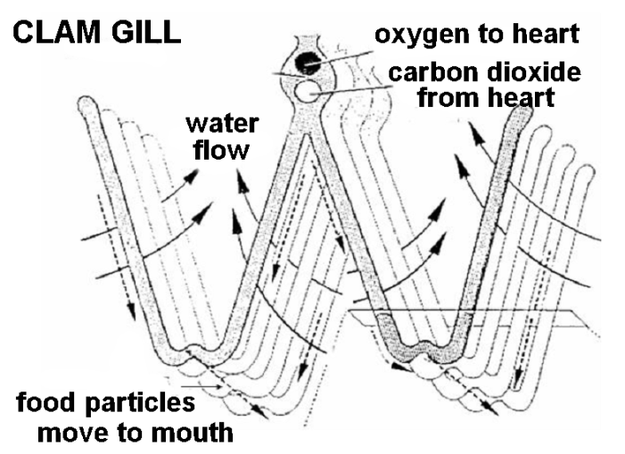

Exercise 2c. Supersolver Questions
Q12. Clams use gills for gas exchange and in the collection of food particles, just as sponges pump water through collar cells. Researchers predict that clams at deeper depths will have much larger gills than individuals of the same species would have in shallow waters. Why might this be the case, and how could they quantitatively test this hypothesis a) in living specimens, and b) in collected specimens from which the gills have been dissected?
Answers to all “supersolver” questions are on the next slides!

Slide 85
Exercise 2c. Answers to Supersolver Questions
Q8. What volume of water does a filter-feeding sponge cycle through its cavity per day if its flagella create a current flow of 75 liters of water/ hr?
In a single day, the sponge would cycle 1800 liters (l) or 1.8 kiloliters (kl) through its cavity.
Q9. Since the typical sponge pumps a volume of water per minute equal to about 5 times its body volume, what is the volume of the sponge under Q8?
The volume of this sponge is 0.25 liters, or 250 cubic centimeters (cm³).
Q10. What volume of water did the anemone force out? The anemone is a cylinder in shape with a height of 3.8 cm and a diameter of 4.25 cm
The volume of a cylinder is V = πr²h, where the radius r = ½ of its diameter.
The volume of this anemone is approximately 3.14(2.13²) = 14.3 cm³ or 14.3 ml. If the anemone contracted to 10% its height, this would mean that it forced out approximately 12.9 ml of water.

Slide 86
Exercise 2c. Answers to Supersolver Questions
Q10. What volume of water did the anemone force out? The anemone is a cylinder in shape with a height of 3.8 cm and a diameter of 4.25 cm
The volume of a cylinder is V = πr²h, where the radius r = ½ of its diameter.
The volume of this anemone is approximately 3.14(2.13²) = 54.16 cm³ or 54.16 ml. If the anemone contracted to 10% its height (to a height of 0.38 cm), this would reduce the contracted anemone to a volume of 5.42 mL. This means that the anemone forced out approximately (54.2 – 5.4) or 48.8 mL of water.

Slide 87
Exercise 2c. Answers to Supersolver Questions
Q11a. What is the volume of the Volvox colony in microliters? The Volvox colony and individual cells within it are spherical in shape. The equation for the volume of a sphere is V = 4πr³/3
So, the overall volume of the Volvox mother colony would be
4π(1500 μm)³/3 = 4π(1500 × 10⁻⁶m)³/3 = 1.41 × 10⁻⁸m³
Since a microliter is equal to 1.0 × 10⁻⁹m³, the volume of the colony in microliters is
1.41 × 10⁻⁸m³/ 1.0 × 10⁻⁹m³ = 1.0 × 10⁻⁹m³ = 14.1 μl

Slide 88
Exercise 2c. Answers to Supersolver Questions
b) What is the volume of the indicated daughter colony in microliters?
In measuring the two lines in the Volvox figure, we learn that the indicated daughter colony has a diameter of approximately 0.327 of the 3000 micron diameter of the mother colony, or a diameter of 981 microns. Its radius is 490.5 microns. The volume of the daughter colony is
4π(490.5 μm)³/3 = 4π(490.5 × 10⁻⁶m)³/3 = 4.94 × 10⁻¹⁰m³
Since a microliter is equal to 1.0 × 10⁻⁹m³, the volume of the colony in microliters is
4.94 × 10⁻¹⁰m³/ 1.0 × 10⁻⁹m³ = 4.94 × 10⁻¹m³ = 0.494 μl

Slide 89
Exercise 2c. Answers to Supersolver Questions
Q12. Clams use gills for gas exchange and in the collection of food particles, just as sponges pump water through collar cells. Researchers predict that clams at deeper depths will have much larger gills than individuals of the same species would have in shallow waters. Why might this be the case, and how could they quantitatively test this hypothesis.
There would be less oxygen available in the depths of the ocean, because photosynthesis, which releases oxygen, occurs only in the photic zone receiving light. Shallow waters layer will also gain additional oxygen through gas exchanges occurring at the surface. Therefore, clams at deeper depths might be expected to have larger gills to be able to obtain their oxygen requirements from the less oxygenated habitats.

Slide 90
Exercise 2c. Answers to Supersolver Questions
To quantitatively test this hypothesis in living specimens, biologists release a known volume of water containing dye (e.g., food coloring) at the incurrent syphon of test clams where water is pulled in by the action of cilia. They then time the release of the dye as the water containing it is expelled from the clam. Using this method, they can quantitatively compare pumping rates (the volume of water moved through the gills per unit time) in clams. The larger the gill volume, the greater the pumping rate.
In dissected specimens, water displacement would be a good approach to comparing the relative size of gills collected from clans at the two depths.

Slide 91
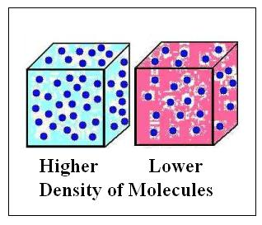
Exercise 3: Density
Often, you judge how much mass an object has by its volume. For example, you think of a refrigerator as being more massive than a toaster because it has a greater volume.
Size can be used as an indication of mass, but appearances can be deceiving. The material from which an object is made also influences its mass. Materials have different densities. The density of a material is a measure of how tightly the matter making up the material is packed together. An object made of low density material may seem light for its size, while an object made of high density material may seem heavy for its size.

Slide 92
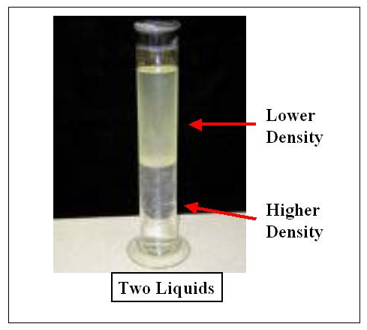
Exercise 3: Density
Think about a china dinner plate versus a paper picnic plate of the same volume. The china plate will be heavier than the paper plate, because bone china is denser (the mass is packed more closely together) than paper.
When two liquids of differing density are combined, low density liquids rise to the top, while more dense liquids move to the bottom: they separate as shown to the right.

Slide 93
Exercise 3a: Estimating the densities of cubes composed of different materials
The density of an object is a function of its mass and volume:
Density = mass/volume (or, written symbolically, D = m/V)
In Exercise 3a, we will experiment with the relationship between the material an object is made of and the object’s mass. However, first you will need to set up your balance and calibrate it.
Find the balance and make sure the pans are centered on either side.
Before you take any measurements, you need to calibrate your balance. You will need to calibrate the balance frequently as you go through the following exercises to assure the accuracy of your data.

Slide 94
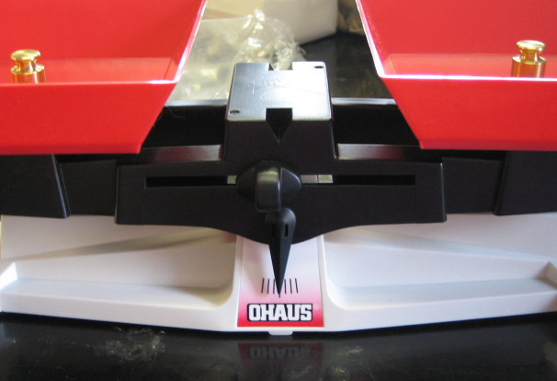
Exercise 3a: Calibrating Your Balance
Take out the box with the calibration masses, and remove the set of masses. Find two of the masses with the number 20 printed on the top.
Place one 20g mass on each tray. If the scale is calibrated, the trays should be level and the center needle (pointer) should point to the largest center line, as shown in the picture below. Get down to eye level with the needle for the most accurate reading.
Adjust the black knob above the needle until the needle comes to rest on the center line, as shown in the figure below.
Your balance is calibrated!

Slide 95
Exercise 3a: Calibrating Your Balance
Remove the poplar cube from the box containing the set of density blocks, and place it in one of the trays of your balance. Place the numbered masses on the other tray until you can determine the mass of the block. You will have to round out the mass estimate for the cube to the nearest gram, as there are no masses of less than one gram available.
Record the mass in the Data Table 1 (shown on the next slide).
Repeat this procedure until all blocks are measured.
Find the volume of each cube by measuring the length of one of its sides and using the formula from exercise 2b. (V = l × w × h)
Remember, for a cube, the measurements for length, width, and height are the same.
Record the volumes of the cubes in the table.
Using your data for mass and volume, complete the column labeled “Measured Density” in the data table by using the density formula
      D = m/V

Slide 96
Exercise 3a: Calibrating Your Balance
Remove the poplar cube from the set of density blocks, and place it in one of the trays of your balance. Place the numbered masses on the other tray until you can determine the mass of the block. You will have to round out the mass estimate for the cube to the nearest gram, as there are no masses of less than one gram available.
Record the mass in the Data Table 1 (shown on the next slide).
Repeat this procedure until all blocks are measured.
Find the volume of each cube by measuring the length of one of its sides and using the formula from exercise 2b.
V = l × w × h
Remember, for a cube, the measurements for length, width, and height are the same.

Slide 97
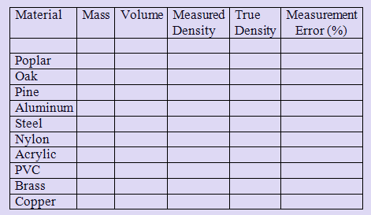
Exercise 3a: Directions

Slide 98
Exercise 3a: Directions
Record the volumes of the cubes in the table.
Using your data for mass and volume, complete the column labeled “Measured Density” in the data table by using the density formula
      D = m/V
Go to the next slide for information on calculating percent error to add to the “Measurement Error (%)” column of this table!

Slide 99

Exercise 3b. Calculating percent error
Remember that the masses in your table are only approximations, because our smallest mass standard was 1g. Errors in measurement result not only from the limitations of our tools, but the limitations of our senses.
On the next slide, you will find the true densities of each of the materials from Exercise 3a. NO PEEKING until after you have already gotten your measured values for the densitites of the cubes!
Record the true densities in your table.
Now you are ready to determine the percent error of your measurements. Percent error will tell you the accuracy of your measurements.

Slide 100
Exercise 3b. Calculating percent error
Using the formula, calculate the measurement error for each of the blocks.
Fill in the final column of your table.
Your percent error can reflect an overestimate (>0) or an underestimate (< 0) of the true density.
Was there a trend in the error of your estimates? That is, did you tend to overestimate the density, or to underestimate it? If so, what might be some reasons for this trend?

Slide 101
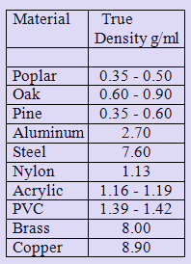
Exercise 3b. Calculating percent error
To the right is a table displaying the densities of each of the materials from which the cubes in Exercise 3a are made.
Use these values to calculate your percent error for your measurements of density of each of the materials.
Since some of the values listed in the table list a range of densities for particular materials, use the midpoint of the range of density values of those materials as the true value when making your calculations.

Slide 102
Exercise 3c. Density in Biology & Technology
Now that you understand the concept of density, see if you can answer the following biological and technological questions:
Q1. Poplar, aspen and may pine tree species have wood that is low in density, while maple and beech trees are at the high end of wood density. What is the difference in the habits and life histories of these trees that would explain the differences in their wood densities?

Slide 103
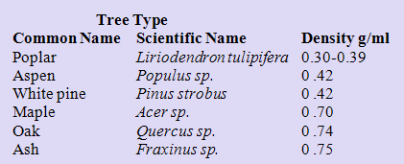
Exercise 3c. Density in Biology & Technology
Q2. Use the wood densities listed in the table below to match each tree species with its use. A given tree species may have more than one purpose, and the same object might be made from different woods. Uses: wood sculptures, pallets, paneling, flooring, matchsticks, bats, furniture, plywood, composites, paper

Slide 104
Exercise 3c. Questions
Now that you understand the concept of density, see if you can answer the following biological and technological questions:
Q3. Because density influences mass, would you expect bone density to differ between terrestrial mammals and birds? If so, what pattern would you expect to exist between the two?
Q4. How would you expect the densities of marine mammals to compare to the densities of terrestrial mammals?

Slide 105
Exercise 3c. Questions
Q5. When it comes time to prepare the gravy to accompany the turkey that has been baking in the oven all day on Thanksgiving, the cook attempts to remove as much fat as possible from the juices that have accumulated in the bottom of the roasting pan. How can this be done?
Go to the next slides for answers to these questions and the questions from the previous slides!

Slide 106
Exercise 3c. Density in Biology & Technology
Q1. Poplar, aspen and many pine tree species have wood that is low in density, while maple and beech trees are at the high end of wood density. What is the difference in the habits and life histories of these trees that would explain the differences in their wood densities?
Pines, poplars, & aspen are fast growing pioneer, or weedy tree species. They are among the first trees to invade a grassland or disturbed habitat, so there is little competition for sunlight. In producing rapid growth in height, cell density is sacrificed. However, maples & beech are late succession tree species that grow slowly under the shade of a forest canopy. Rather than emphasize height, they put more energy into cell density. There is a greater energetic cost to producing high density wood, but greater longevity associated with higher cell densities. Thus, maples and beeches will live longer.

Slide 107
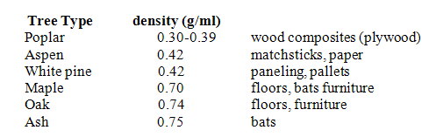
Exercise 3c. Density in Biology & Technology
Q2. Use the wood densities listed in the table below to match each tree species with its use.

Slide 108
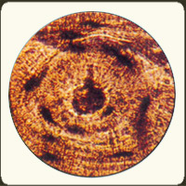
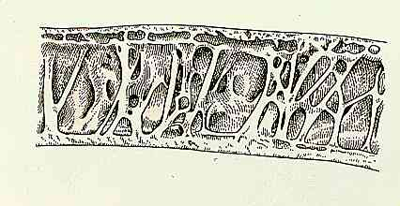
Exercise 3c. Questions
Q3. Because density influences mass, would you expect bone density to differ between terrestrial mammals and birds? If so, what pattern would you expect to exist between the two?
Birds have much less dense bones then mammals because they need to have as little mass as possible to obtain lift. As you have learned from wood, the more dense the material, the stronger it is. Birds use a strut framework within their hollow tubes to supply the strength they have lost through low bone density.
Cross section of compact mammal bone
Internal view of bird limb bone

Slide 109
Exercise 3c. Questions
Q4. How would you expect the densities of marine mammals to compare to the densities of terrestrial mammals?
This is a complex problem, typical to biology. Since sea water provides support, one would expect that there would not be selection pressure for less bone mass. However, sea mammals are adapted from terrestrial relatives, and there is evidence that greater bone density has been selected for in mammals that occupy shallow waters. The greater density provides ballast that aids the mammal in maintaining position in the water. Marine mammals in deep water, however, have reduced bone density with cross sections of their bones resembling a case of osteoporosis.

Slide 110
Exercise 3c. Questions
Q5. When it comes time to prepare the gravy to accompany the turkey on Thanksgiving, the cook attempts to remove as much fat as possible from the juices in the roasting pan. How can this be done?
Fat (lipids) are lower in density than the flavored water (juices) released from the turkey as it roasts. Cooks use a spoon to skim off the fat from the remainder of the gravy. There are also special containers to do this. Biologists use a similar technique in determining lipid content of animal tissue. A tissue sample is homogenized in a blender and allowed to settle following spinning in a centrifuge. The relative volume of the lipid layer floating to the top of a graduated cylinder to other tissue fluids is determined, and each layer present in the homogenate is separated from the others for use in further tests.

Slide 111
Exercise 4: Exploring object size, shape, density, and mass (Lower Grades)
Locate the box containing several miscellaneous items.
This box contains: 3 hickory nuts, 5 pieces of string, 1 acorn, 1 stone, 1 cotton ball, 1 feather, 5 paper clips, 2 noodles, 1 plastic cap, 1 prickly seed ball.
The objects in this box vary in size, shape, and density. In this exercise, you will explore how these properties are related to mass.
The questions on the next slide will aid you in this exploration. Use different combinations of weights to answer as many of the questions as possible.
Then, develop and answer your own questions about these objects and others that you have in your room.
Be sure to put all materials back in the appropriate boxes when you are finished.

Slide 112
Exercise 4: Exploring object size, shape, density, and mass (Lower Grades)
What is the approximate mass of three hickory nuts?
Do different hickory nuts have the same mass?
If not, why might they differ in mass?
Do acorns differ in mass?
How does the mass of an acorn cap compare to the mass of an acorn nut?
Is the mass of a hickory nut greater than that of an acorn?
What is the approximate mass of two spiral noodles?
If you know the mass of two noodles, can you estimate the mass of one noodle without using the balance?

Slide 113
Exercise 4: Exploring object size, shape, density, and mass (Lower Grades)
Why might two noodles be more similar in mass than two nuts?
Which has a smaller mass: two pieces of woven string or two paperclips?
Which has greater mass: a feather, a ball of cotton, or a polystyrene peanut?
Is the mass of the stone equal to the mass of three hickory nuts?
Is there an item in from the box of miscellaneous items with a mass of approximately five grams? If so, what is it?
What is the mass of the mystery hexagonal metal column?
How does the mystery hexagonal metal column compare in size to the corresponding standard calibration weight?

Slide 114
Exercise 4: Exploring object size, shape, density, and mass (Lower Grades)
Super-Solver Problem
Rank the following objects from most to least massive:
Acorn, cotton ball, feather, felt disk, hickory nut, metal washer, plastic cap, polystyrene peanut, spiny seed ball, and stone.
Now rank the same set of objects according to volume. You can estimate the volume of each object by estimating the product of each object’s length, width, and height, that is, V = l × w × h.
How do the two rankings compare? What contributes most to the difference between the two rankings (shape, size, or type of material)?

Slide 115
Directions
Use the balance and standard weights to measure the masses of various objects.
You can also use the rings and square weights in these determinations.
  The mass of each standard metal weight is inscribed on its top where 1 = 1 gm, 20 = 20 gms and so on.
  In Exercise 1 we determined the weight of
    yellow square to equal 1 gram,
    orange square to equal 5 grams,
    purple square to equal 10 grams.

Slide 116
TO BEGIN . . .
You will need
Balance
Box with six calibration masses
Box with 40 circular discs/rings
Box with colored blocks
Box containing 3 hickory nuts, 5 pieces of string, 1 acorn, 1 stone, 1 cotton ball, 1 feather, 5 paper clips, 2 noodles, 1 plastic cap,1 prickly seed ball
Box with styrofoam packing peanuts

Slide 117
Directions continued
Find the box that contains a number of objects that differ in size, shape and density of material.
As a class, explore the relationships among the above characteristics of objects and mass.
  To help you get started in this exploration, complete experiments that will answer the questions that follow.

Slide 118
Discussion Questions
What is the approximate mass of three hickory nuts?
Do different hickory nuts weigh the same?
If not, why might they differ in mass?
Do acorns differ in mass?
What does an acorn cap weigh relative to the nut itself?
Does a hickory nut weigh more than an acorn?
Approximately how much do two spiral noodles weigh?
If you know how much two noodles weigh, can you estimate the mass of one noodle without weighing it?

Slide 119
Discussion questions continued
Why might two noodles be more equal in mass than two nuts?
Which has a smaller mass: two pieces of woven string or two paperclips?
Which weighs more: a feather, a ball of cotton, or a polystyrene peanut?
Does the stone have the same mass as three hickory nuts weighed together?
Is there an item in box of miscellaneous items that weighs approximately five grams? If so what is it?
What is the mass of the mystery hexagonal metal column?
How does the mystery hexagonal metal column compare in size to the corresponding standard weights?

Slide 120
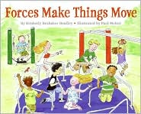
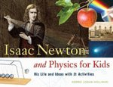
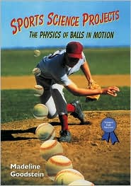
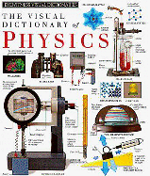
Suggested Reading
Grades K-3
What Is the World Made Of? All About Solids, Liquids, and Gases - Kathleen Weidner Zoehfeld and Paul Meisel
Solids, Liquids and Gases - Ontario Science Centre and Ray Boudreau
Gravity Is a Mystery - Franklyn M. Branley and Edward Miller
What is Gravity? - Lisa Trumbauer
Simple Machines - Deborah Hodge and Ray Boudreau
What's the Matter in Mr. Whiskers' Room? - Michael Elsohn Ross and Paul Meisel (Illustrator)
Forces Make Things Move - Kimberly Brubaker Bradley and Paul Meisel
Grades 4-7
Matter (Discovery Channel School Science) - Gareth Stevens Publishing
Can You Feel the Force? - Richard Hammond
Fatal Forces (Horrible Science) - Nick Arnold
The Spinning Blackboard and Other Dynamic Experiments on Force and Motion - Paul Doherty and Don Rathien
Forces and Movement - Peter D. Riley
Forces and Motion - Alvin Silverstein, Virginia B. Silverstein, and Laura Silverstein
Isaac Newton and Physics for Kids: His Life and Ideas with 21 Activities - Kerrie Logan Hollihan
Grades 7+
Eyewitness Visual Dictionary of Physics - DK Publishing
Sports Science Projects: The Physics of Balls in Motion - Madeline P. Goodstein
Isaac Newton and the Scientific Revolution - Gale E. Christianson

Slide 121
Scientific Journal Articles (included on Teacher CD!)
Bisbee, G.D. and C.A. Kaiser. 1997. Milkweed seed dispersal: A means for integrating biology and physics. The American Biology Teacher 59(7):426-427.
Magnusson, W.E., A.P. Lima, W. Alves da Silva, and M. Carmozina de Araújo. 2003. Use of geometric forms to estimate volume of invertebrates in ecological studies of dietary overlap. Copeia 2003(1):13-19.
Ryser, P. 1996. The importance of tissue density for growth and life span of leaves and roots: A comparison of five ecologically contrasting grasses. Functional Ecology 10(6):717-723.

Slide 122
Links (all underlined text is clickable!)
Mass and Matter – website from Kennesaw State University; provides numerous links to information on matter, mass, atoms, and molecules.
Physical Science Interactive Web Sites - A quite comprehensive list of interactive physics websites compiled by Jerrie S. Cheek at the Educational Technology Training Center at Kennesaw State University. Divided into subject-specific sections such as matter, force and motion, atoms, radioactivity, the periodic table, atomic and molecular motion, transformations and flow of energy, waves, and electricity and magnetism.
PhysicsCentral - Learn how your world works! A website by the American Physical Society. Be sure to check out Physics@Home, which presents several physics experiments easily completed both at home and in the classroom!
Mass - Site from the New Zealand Ministry of Education providing a variety of exercises about mass appropriate for grades K-3.
Shape and Space (Measurement) - Website from British Columbia's Ministry of Education providing activities and resources regarding measurement of shape and space for grade levels K-7.
Physics4Kids.com: Motion - Great introductory website presenting information on forces, vectors, laws of motion, energy of motion, velocity, momentum, friction, gravity, and work.
Forces and Motion - Cool website from Cislunar Aerospace (funded by NASA) that offers beginner, intermediate, and advanced activities on forces and motion, complete with checklists of skills/techniques utilized by each.
Exploratorium: Sport Science - Great website for getting athletic types interested in science! Presents the physics and biomechanics behind numerous sports.
IBEAM (Integrating Biology Experimental Activity Modules) with Introductory Physics – Another great website from Kennesaw State. Contains activities illustrating opposing forces, acceleration due to gravity, center of mass, and several others, and how they relate to biological systems.
Light and Matter - Open source physics textbooks!
Insultingly Stupid Movie Physics - An amusing site that highlights examples of bad physics in movies. Even has a section on how to use movie physics in the classroom, including lists of movie scenes with activities based on corresponding physical principles, HERE.

